Slide 1

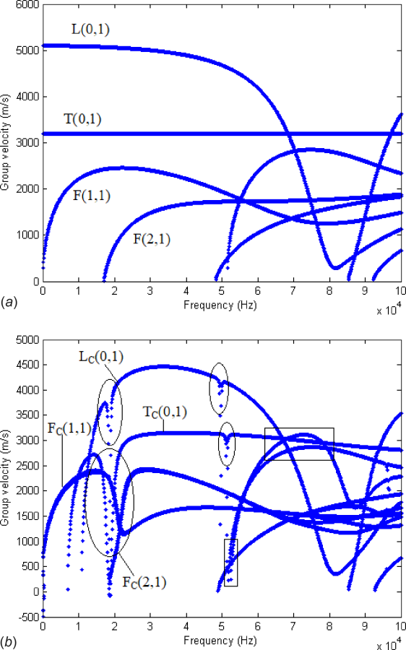
Date of download: 4/17/2024
Copyright © ASME. All rights reserved.
From: Study on Mode Repulsion of Ultrasonic-Guided Waves in Pipe Bends
J. Pressure Vessel Technol. 2019;142(3). doi:10.1115/1.4045525
Figure Legend:
Group velocity dispersion curves for a straight pipe and a pipe bend: (a) group velocity dispersion curves for a straight pipe and (b) group velocity dispersion curves for a pipe bend

Slide 2
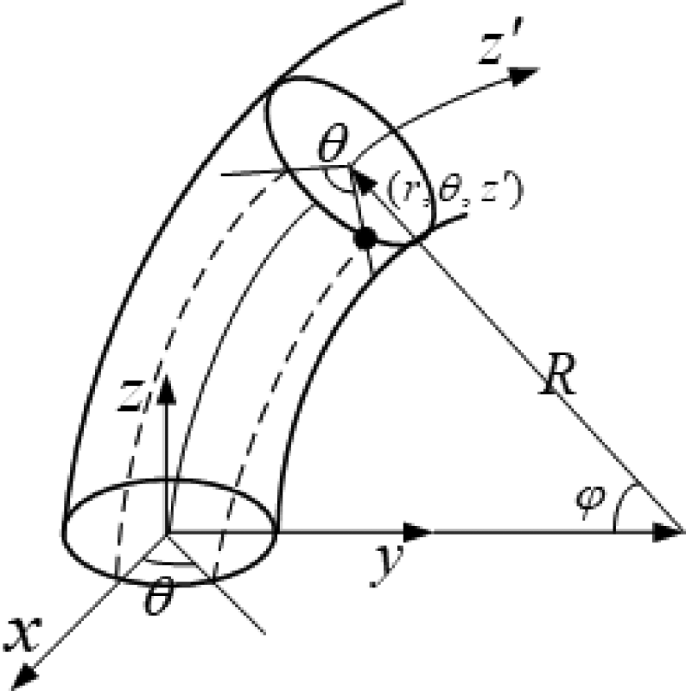
Date of download: 4/17/2024
Copyright © ASME. All rights reserved.
From: Study on Mode Repulsion of Ultrasonic-Guided Waves in Pipe Bends
J. Pressure Vessel Technol. 2019;142(3). doi:10.1115/1.4045525
Figure Legend:
Quasi-cylindrical coordinate system [4]

Slide 3
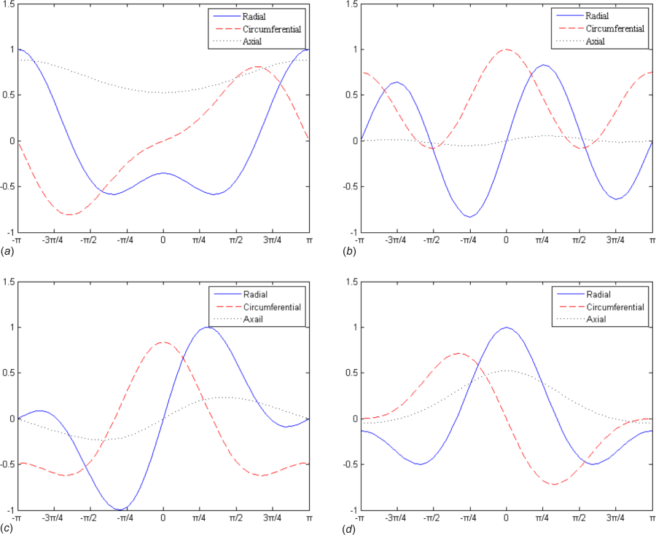
Date of download: 4/17/2024
Copyright © ASME. All rights reserved.
From: Study on Mode Repulsion of Ultrasonic-Guided Waves in Pipe Bends
J. Pressure Vessel Technol. 2019;142(3). doi:10.1115/1.4045525
Figure Legend:
Displacement distributions of some modes of pipe bends in the circumferential direction: (a) LC(0,1), (b) TC(0,1), (c) FC(1,1)1, and (d) FC(1,1)2

Slide 4
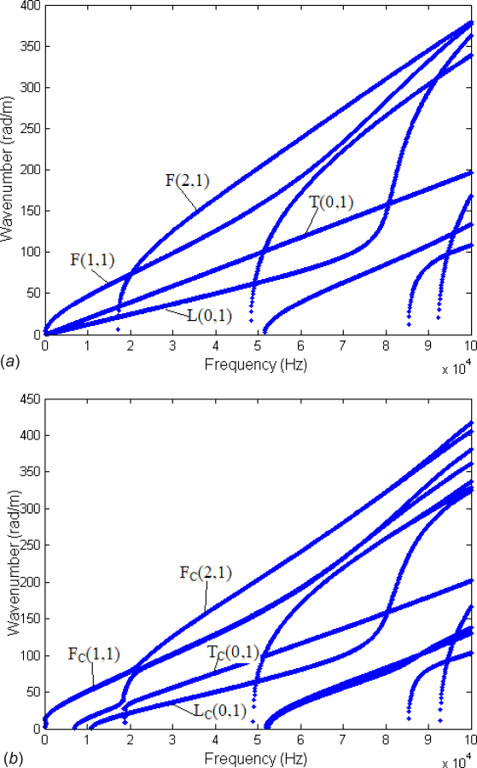
Date of download: 4/17/2024
Copyright © ASME. All rights reserved.
From: Study on Mode Repulsion of Ultrasonic-Guided Waves in Pipe Bends
J. Pressure Vessel Technol. 2019;142(3). doi:10.1115/1.4045525
Figure Legend:
Wavenumber versus frequency dispersion curves: (a) straight pipe and (b) pipe bend

Slide 5
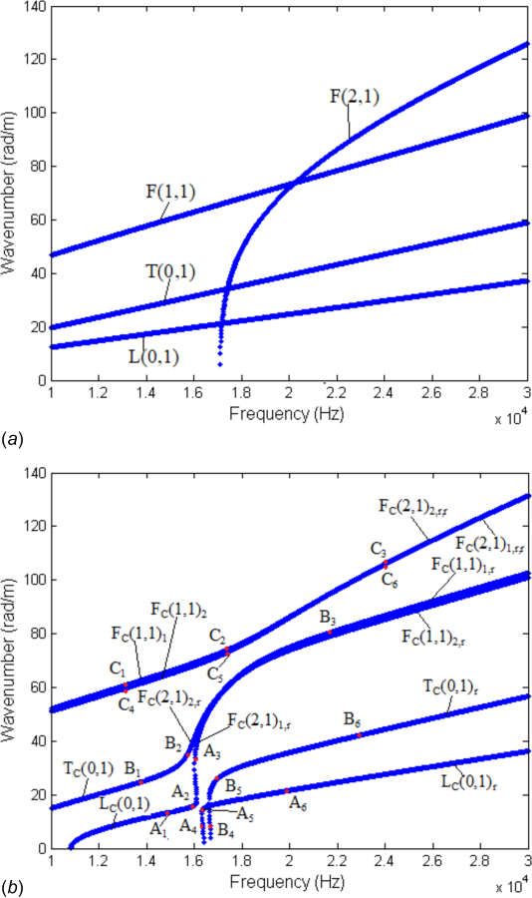
Date of download: 4/17/2024
Copyright © ASME. All rights reserved.
From: Study on Mode Repulsion of Ultrasonic-Guided Waves in Pipe Bends
J. Pressure Vessel Technol. 2019;142(3). doi:10.1115/1.4045525
Figure Legend:
Wavenumber versus frequency dispersion curves in the frequency range from 10 Hz to 30 kHz: (a) straight pipe and (b) pipe bend

Slide 6
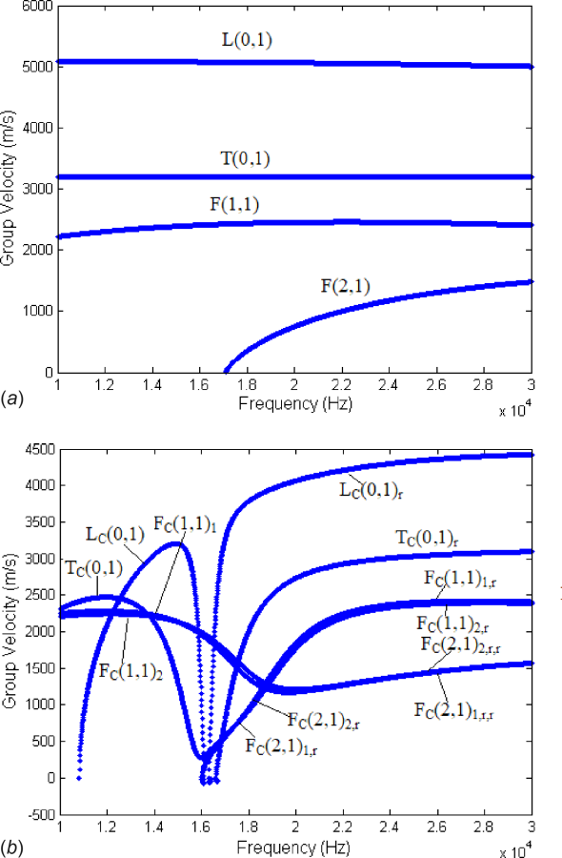
Date of download: 4/17/2024
Copyright © ASME. All rights reserved.
From: Study on Mode Repulsion of Ultrasonic-Guided Waves in Pipe Bends
J. Pressure Vessel Technol. 2019;142(3). doi:10.1115/1.4045525
Figure Legend:
Group velocity dispersion curves in the frequency range from 10 to 30 kHz: (a) straight pipe and (b) pipe bend

Slide 7
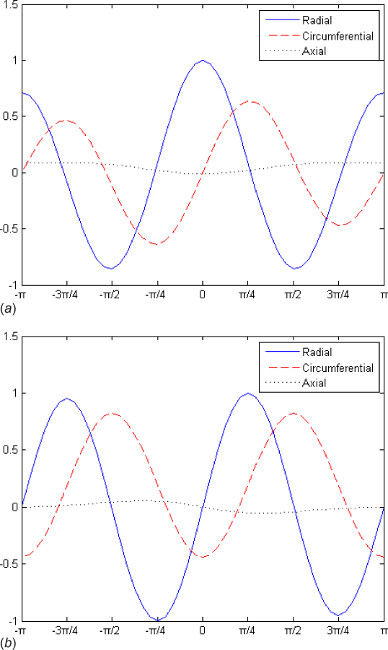
Date of download: 4/17/2024
Copyright © ASME. All rights reserved.
From: Study on Mode Repulsion of Ultrasonic-Guided Waves in Pipe Bends
J. Pressure Vessel Technol. 2019;142(3). doi:10.1115/1.4045525
Figure Legend:
Displacement distributions of FC(2,1)1 and FC(2,1)2 in the circumferential direction: (a) FC(2,1)1 and (b) FC(2,1)2

Slide 8
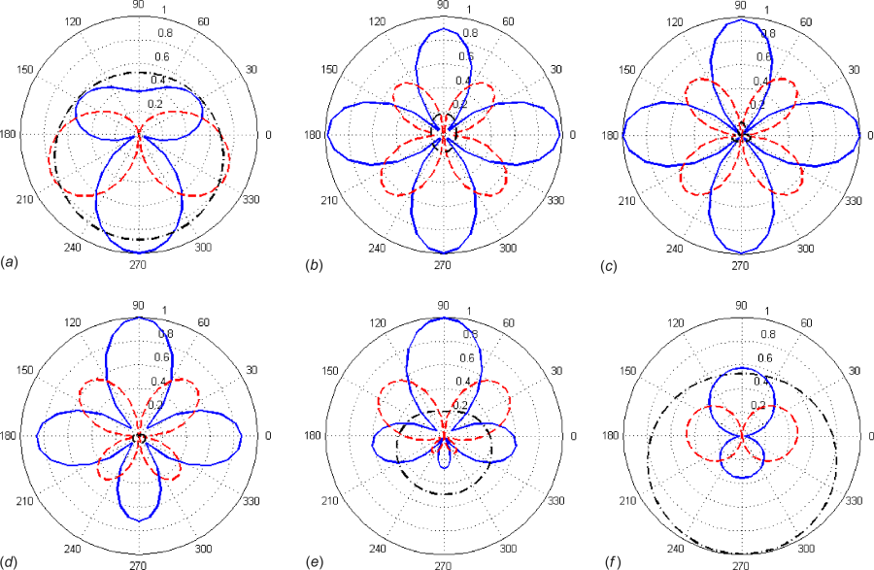
Date of download: 4/17/2024
Copyright © ASME. All rights reserved.
From: Study on Mode Repulsion of Ultrasonic-Guided Waves in Pipe Bends
J. Pressure Vessel Technol. 2019;142(3). doi:10.1115/1.4045525
Figure Legend:
Mode shapes in circumferential direction of points A1–A6 in Fig. 5(b) (blue solid line, red dotted line, and black dashed–dotted lines are displacements in radial, circumferential, and axial directions, respectively): (a) A_{1,} (b) A₂, (c) A_{3,} (d) A_{4,} (e) A_{5,} and(f) A₆

Slide 9
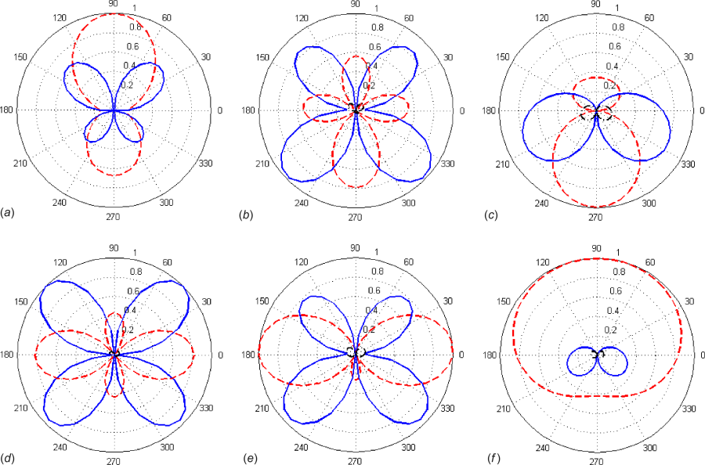
Date of download: 4/17/2024
Copyright © ASME. All rights reserved.
From: Study on Mode Repulsion of Ultrasonic-Guided Waves in Pipe Bends
J. Pressure Vessel Technol. 2019;142(3). doi:10.1115/1.4045525
Figure Legend:
Mode shapes in circumferential direction of points B1–B6 in Fig. 5(b) (blue solid line, red dotted line, and black dashed-dotted lines are displacements in radial, circumferential, and axial directions, respectively): (a) B_{1,} (b) B₂, (c) B_{3,} (d) B_{4,} (e) B_{5,} and (f) B₆

Slide 10
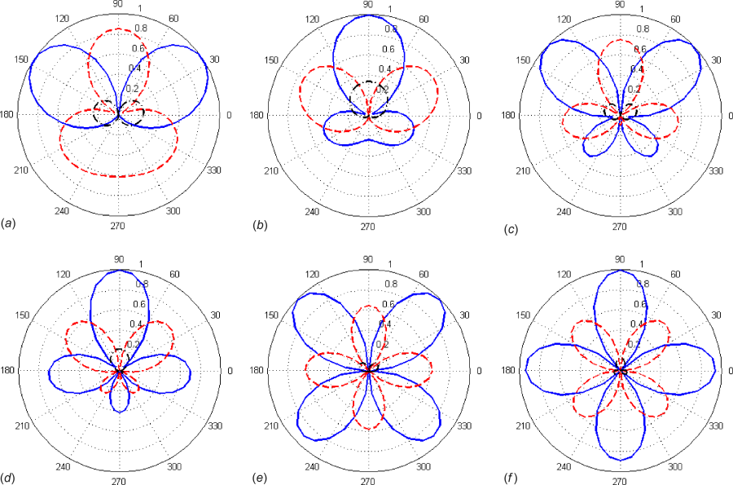
Date of download: 4/17/2024
Copyright © ASME. All rights reserved.
From: Study on Mode Repulsion of Ultrasonic-Guided Waves in Pipe Bends
J. Pressure Vessel Technol. 2019;142(3). doi:10.1115/1.4045525
Figure Legend:
Mode shapes in circumferential direction of points C1–C6 in Fig. 5(b) (blue solid line, red dotted line, and black dashed-dotted lines are displacements in radial, circumferential, and axial directions, respectively): (a) C_{1,} (b) C₂, (c) C_{3,} (d) C_{4,} (e) C_{5,} and (f) C₆

